Slide 1

Hybrid Topology
IDB-BISEW IT Scholarship Project
(Networking Technologies Course)
Presented by
Md. Masud Rana
ID: 1203979
Round: 28

Slide 2
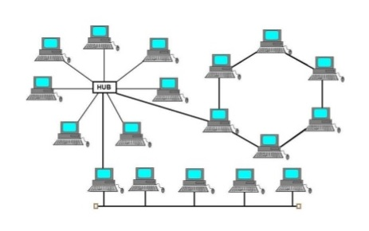
What is Hybrid Topology ?
A hybrid topology is a type of network topology that uses two or more other network topologies, including bus topology, ring topology, star topology etc.
We can say that, the combination of more topologies is known as hybrid topology.
#Hybrid Topology

Slide 3

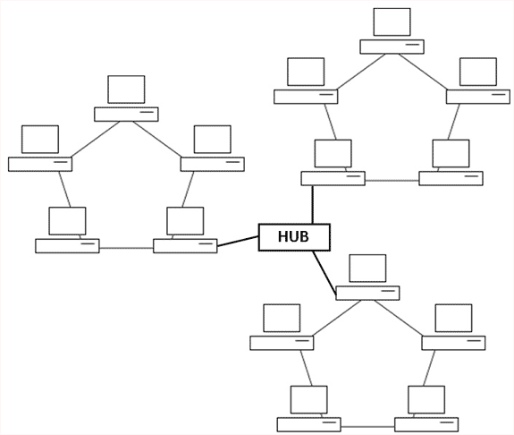
Types of hybrid topology
Star - Bus: The star – bus topology is combined with the linear bus in Large networks. In such cases the linear bus provides a backbone that connects multiple stars.
Star - Ring: he Star Ring is a combination of ring and star topologies. The hubs in a star ring are connected in a star pattern by the main hub.
# Star-Bus Topology
# Star-Ring Topology

Slide 4
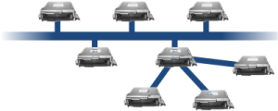
Working of Hybrid Topology
The Hybrid topology scheme combines multiple topologies into one large topology. The hybrid network is common in large wide area networks. Because each topology has its own strengths and weaknesses, several different types can be combined for maximum effectiveness.
# Hybrid Topology

Slide 5
Advantages of Hybrid Network Topology:
Reliable
Flexible
Effective
Disadvantages of Hybrid Network Topology:
Complexity of Design
Costly Hub
Costly Infrastructure

Slide 6
END
Thank You

